Slide 1
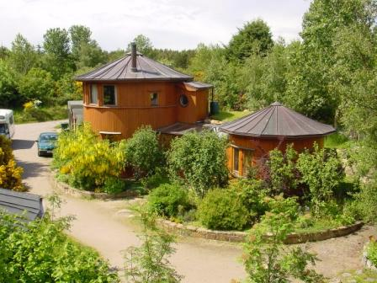
Sustainability Philosophy
ENV200 Environmental Studies
July 2011

Slide 2
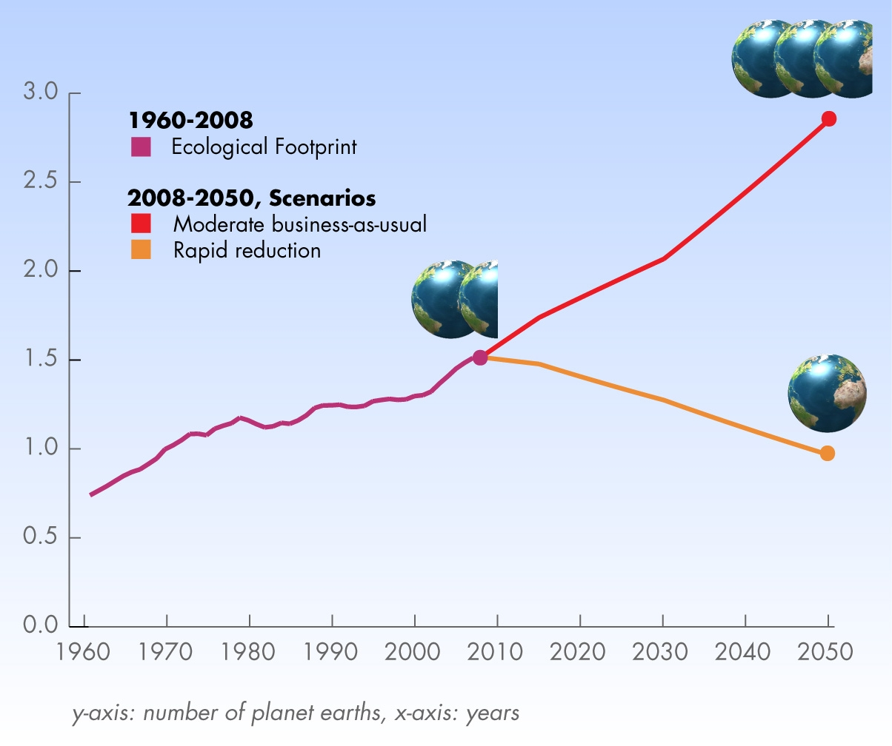



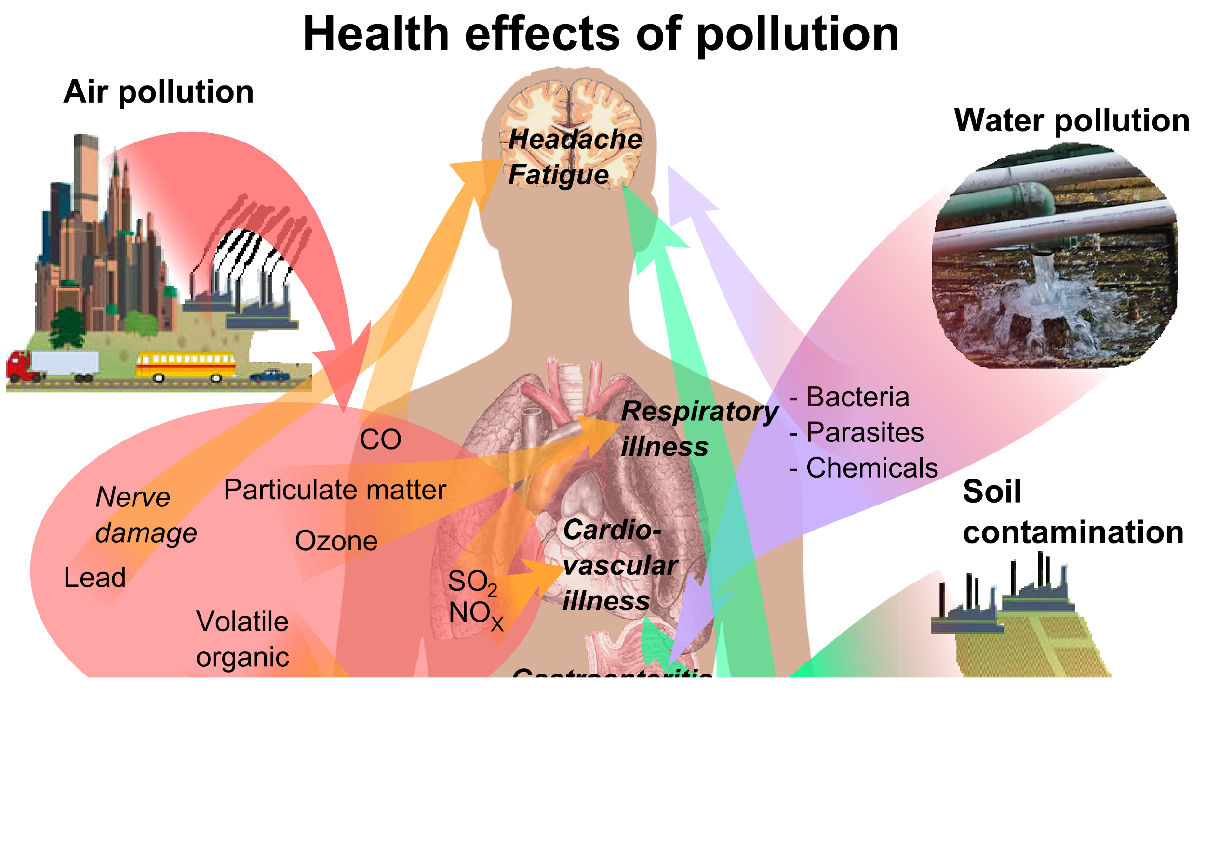
Problem of Unsustainability
Environment in crisis:
Earth-threatening environmental problems
Ecological footprint exceeding Earth’s biocapacity.
Society in crisis:
War, terrorism
Poverty, hunger
Individuals in crisis:
Health and psychological problems
World Footprint www.footprintnetwork.org

Slide 3
We have reached a point where, development, which aims at the survival and prosperity of humanity, ironically threatens our very existence today.
We need a paradigm shift in our approach towards development...Sustainable Development.

Slide 4
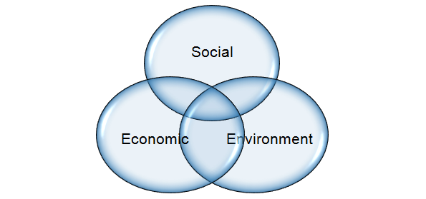
Sustainable Development (SD)
SD is the economic development to meet human needs while preserving the environment.
Meet needs into the indefinite future.
Present economic growth is unsustainable since it leads to social inequities and environmental damage.
Economy, Society, Environment: 3 interdependent and mutually reinforcing pillars of SD.

Slide 5
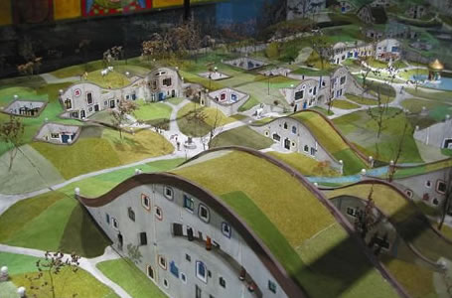
How can we move towards sustainability?

Slide 6
Interactions in Socio-Environmental Problems
Environment
Water Crisis
Food Crisis
Energy Crisis
Economy
Government
Culture
Human Society

Slide 7
Stop deforestation and plant trees
Replace fossil fuels with renewable energy and fuels
Remove poverty and hunger
Reduce, Recycle, Reuse
Ideas for Solving Unsustainability
Stop corruption and crime
Protect wildlife and habitats
Enforce pollution control
Change the government!
Conserve water

Slide 8
Superficial Solutions Cannot Bring Sustainability
Stop Using Plastic Carry Bags
Tune-Up Car Engine to Reduce Emissions
Plant A Few Plants in Your Balcony
Separate Solid Waste in Your Home

Slide 9
Superficial Solutions Cannot Bring Sustainability
Stop Using Plastic Carry Bags
Tune-Up Car Engine to Reduce Emissions
Insufficient!
Plant A Few Plants in Your Balcony
Separate Solid Waste in Your Home

Slide 10
Superficial Solutions Cannot Bring Sustainability
Substantial and Comprehensive Steps and Needed

Slide 11
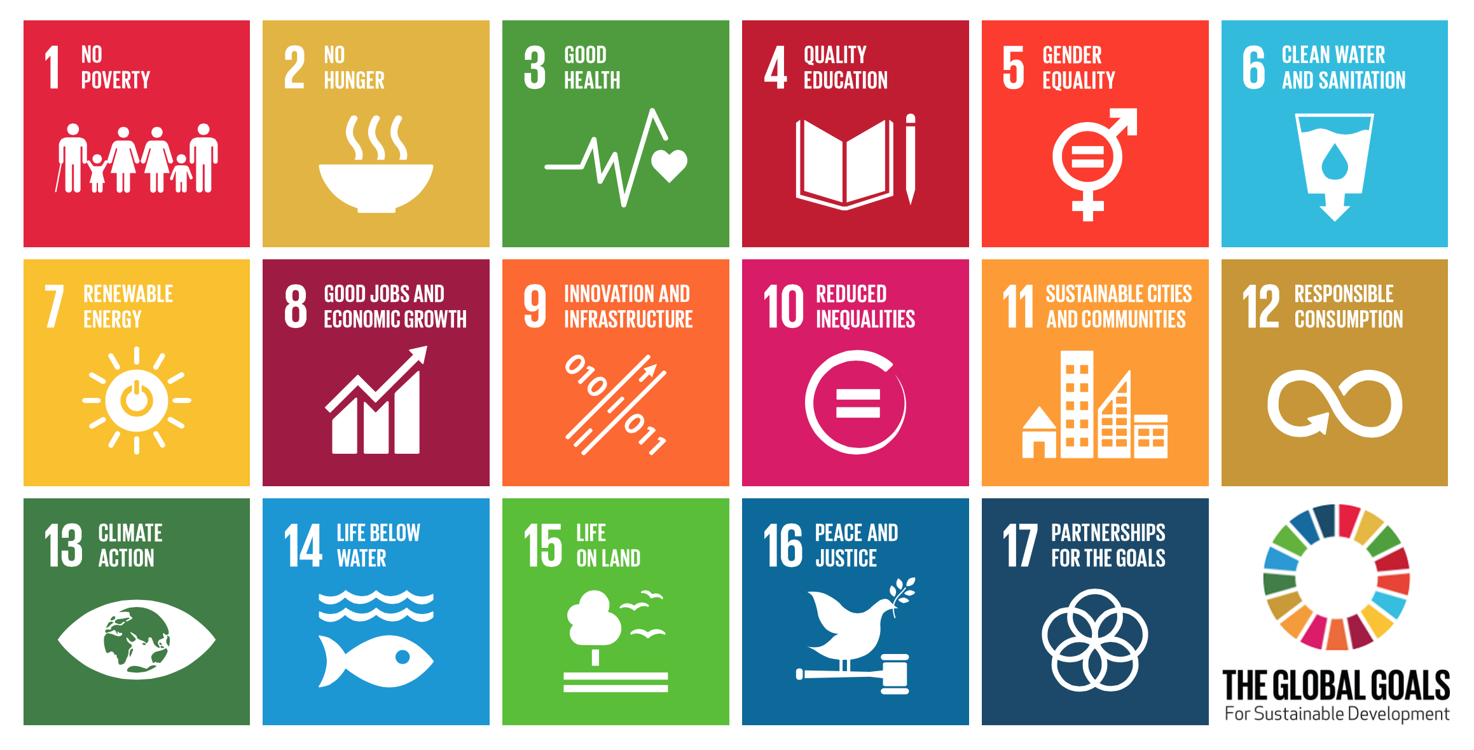
UN’s Sustainable Development Goals
https://en.wikipedia.org/wiki/Sustainable_Development_Goals

Slide 12
Integrated Approach: Coordination is a Must
Government
Sustainability-Based Governance and Policies
Regulatory Agencies
Strict and Impartial Regulation
Industry
Green Businesses & Technologies
NGOs, Consumers, Citizens
Educated, Socio-Environmentally Responsible Citizens

Slide 13
Where do you find all these (or at least many of these) requirements of sustainability implemented?
Nowhere yet in a big way...unfortunately. But...

Slide 14
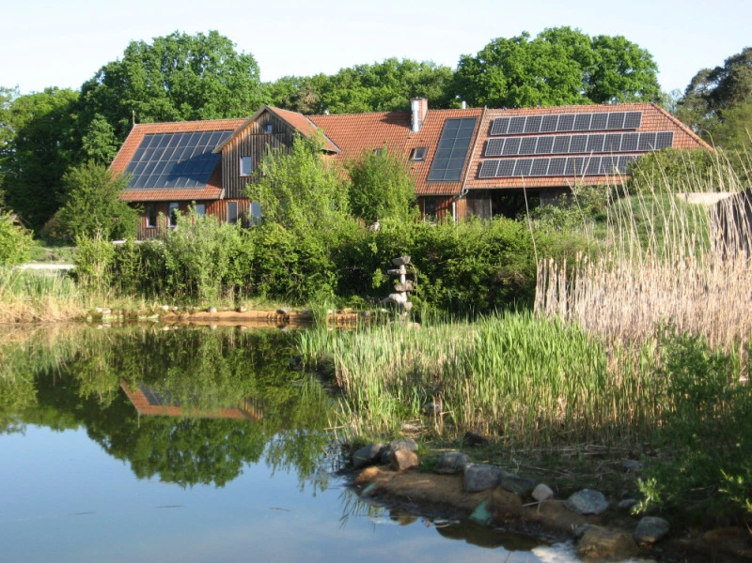
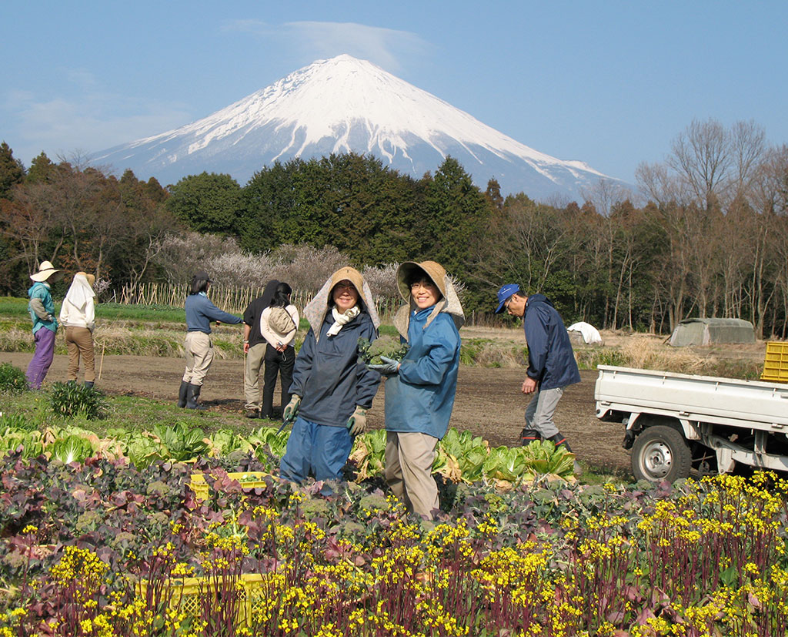
Sustainable Communities, Ecovillages, Eco-Municipalities
www.permaculture.lv
http://ecovillagebook.org/wp/wp-content/uploads/slide8.jpg
Numerous small experiments worldwide prove
the practical feasibility of living sustainably on Earth.

Slide 15
Need to Scale Up
National and Global Sustainability
Eco-Cities
Eco-Villages
A lot of individual effort, collective effort and political will will be required.

Slide 16

Insufficiency of Even an Integrated Solution
But let’s assume that we somehow managed to design and build a sustainable world.
After drastic changes to our:
resource management methods
industrial processes
business and economics
governance, policy and regulation.
Can we be sure that such ‘sustainability’ will last?
Or would it revert to the state of unsustainability?

Slide 17
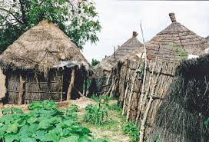
Need for a Permanent Solution
In ancient times, most people lived in villages.
These villages were largely self-sufficient and sustainable, even if technologically primitive.
The drive for more comforts and amenities ended up disrupting the cyclical (sustainable) resource use.
People used technology to fulfill their immediate interests at the expense of the environment.
Collective result → unsustainability.
https://upload.wikimedia.org/wikipedia/commons/5/5e/Old_simpel_primitive_houses_in_Gambia_of_a_village.jpg
Homes, People
Resources
Wastes
Farms, Forests, grasslands

Slide 18

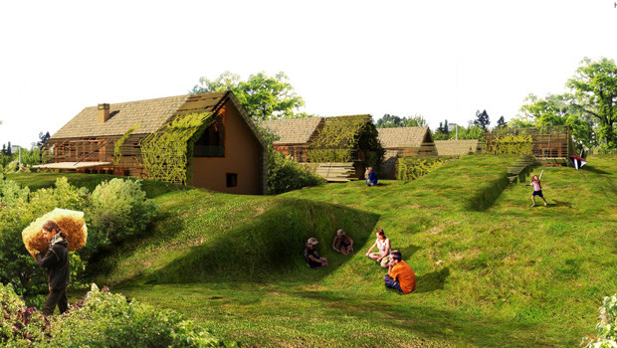
Need for a Permanent Solution
So even if we somehow achieve ‘sustainable development’ in this generation, people will cause it degrade in a couple of generations.
So, such ‘sustainability’ will be temporary at best.
But we need a permanent solution.
Temporary sustainability is not sustainability at all!
https://www.occupycorporatism.com/wp-content/uploads/2013/04/futuristic-eco-city-center1.jpg
http://www.yeniisfikirleri.net/wp-content/uploads/2015/05/eko-koy-620x350.jpg

Slide 19
Cause of Unsustainability: The Missing Link
Sustainability
Tendency for breakdown through acts of social injustice and environmental damage.
What is this invisible force or tendency?
Resistance from politicians, businesses, and individuals
Spontaneous
With Effort
Unsustainability

Slide 20
So what are we missing???
Actually, we are missing the most important thing!
We have not done--a proper diagnosis--a root cause analysis.

Slide 21
How did we assume that sustainability is even possible without understanding what fundamentally causes unsustainability?
A deep enquiry into the root cause of unsustainability is most essential....

Slide 22
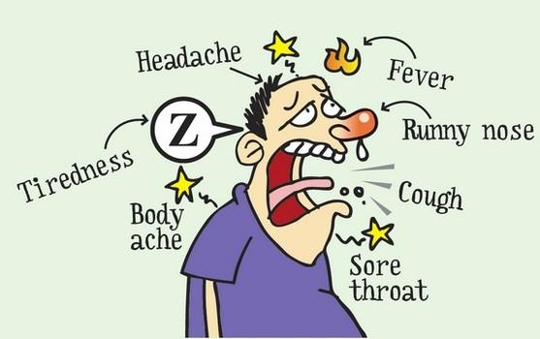
Multiple Symptoms Caused by a Single Common Disease
Two approaches must be pursued simultaneously:
Controlling the external symptoms (temporary solution).
Diagnosis and treatment of the disease (permanent solution).

Slide 23
Common Root Cause for Social and Environmental Problems?
War, Terrorism
Global Warming
Exploitation, Crime
Biodiversity Loss
Common Root Cause?
Poverty, Hunger
Deforestation, Land Degradation
Corruption
Water Crisis
Pollution and Waste

Slide 24
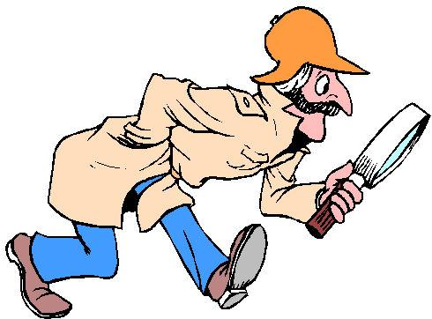
So, let’s start searching for the root cause of
Unsustainability...

Slide 25
Did Technology Cause Unsustainability?
Many of the environmental problems appear to be caused by modern technologies
E.g. Global warming is caused by the discovery and use of fossil fuels, for transportation and power.
Then is scientific development the culprit?
No. Science or knowledge is value-neutral (neither good nor bad) and hence blameless.
Only upon its application, i.e. turning it into technology does it become value-loaded (good/bad).
The actual blame or credit goes to the decision-maker (human), who decides to use any knowledge for a certain application.
The knowledge of explosive chemical reactions can be used by one person for mining rocks for house construction (good application) or by another person, to make a bomb (bad application).

Slide 26
Did Technology Cause Unsustainability?
Why does a human being decide to use knowledge (science) for a certain purpose (good or bad)?
The unsustainability of modern development is the result of some deficiency in the decision-makers.
Even when they were field-experts, they failed at being good and moral human beings.
If these technically competent decision-makers also had high moral integrity, they could have prevented unsustainability by using knowledge for socio-environmentally appropriate technology development.
Humanity, has thus achieved great success at science and technology but it has failed at morality.

Slide 27
Unsustainability: A Moral Failure
For instance take fossil fuel burning and global warming:
Knowledge/Science (value-neutral):
Combustion of a carbonaceous material in air leads to the release of heat accompanied by a volumetric expansion.
Large reserves of buried carbonaceous material are available.
Application (value-loaded):
the petroleum drilling entrepreneur decides to drill an oil well and sell the oil for profit to a refinery owner; both neglect environmental or social impacts.
Another entrepreneur sets up a plant to make cars; no pollution or global warming effects are considered.

Slide 28
Unsustainability: A Moral Failure
Application (value-loaded): …continued
Rich people buy several cars; even inefficient gas-guzzlers for luxury and thrill; with total disregard to the environment or society.
The field experts (engineers, managers, consultants, etc.) and other allied businessmen accept salaries, fees or profits without questioning the company’s intentions or considering the socio-environmental impacts.
The Result: Unsustainability → global warming, pollution and associated human deaths and illness, environmental degradation.
At each step, human beings took decisions based on selfish interest alone; disregarded the impacts on society and environment—Tragedy of the Commons.
A series of moral failures of human beings at each level.

Slide 29
Let’s try to understand the relation between our consumption of resources and sustainability.

Slide 30
Consumption and Unsustainability
Most environmental problems are linked to consumption of material and energy resources.
Most social problems are related to control over resources (wealth and power).
Thus, the cause of unsustainability is related to
CONSUMPTION.

Slide 31
But we need to consume in order to survive.
What’s wrong with it?
True. There’s nothing wrong with consumption for the sake of survival...but when we consume, is our focus on survival or something else?

Slide 32
Motivation for Consumption
Satisfying our physical needs is consumption.
It is the means to survival.
And how do we know what to consume, when to consume and how much to consume?
Nature has given us the pleasure and insecurity/pain mechanism.
They are Nature’s reward & deterrent mechanism.
They motivate action (consumption) and ensure the individual’s survival.
They are like an indicator telling us when and how much to act.
So in effect, we act and consume so that we feel secure or pleasure (and to minimize the feelings of insecurity or pain).

Slide 33
Further, since our security and pleasure is tied to that of our family (by instinct and circumstances), we work (act) even for the sake of their consumption.
But mental factors (thoughts) can greatly influence this ‘indicator’ mechanism.
So it is not a reliable indicator of what we need for survival, esp. after securing physical survival.
In other words, whatever I want or whatever gives pleasure, need not be necessary for my survival or long term benefit.

Slide 34
So actually, any call for action by this mechanism, must be resolved not merely by action (leading to consumption) but also by appropriate thinking (knowledge).
I.e. We must think before we act upon our impulses.
But alas we often don’t!

Slide 35
Needs vs. Wants
Thus, consumption is necessary for survival.
But all that we consume is not required for our survival.
Being tuned to the pleasure-pain mechanism, we normally consume to maximize our feelings of security and pleasure.
We don’t usually check if that consumption is really necessary for survival (of oneself/family).
Our focus becomes security and pleasure; not survival.

Slide 36
Unethical Consumption Causes Unsustainability
Hence, there is a tendency towards unethical consumption:
Consuming what rightfully belongs to another (stealing, corruption, etc.).
Consuming excessively even when others face scarcity or the adverse impacts of your consumption (greed).
This unethical consumption leads to unsustainability.
In general, we can say that unethical behavior (immorality) leads to unsustainability.

Slide 37
Why do we behave unethically?
Unethical behavior (and consequently unsustainability) is the result of two misconceptions regarding consumption.

Slide 38
What Causes Selfish and Unethical Behavior?
Knowledge
Action
Right Knowledge
Smoking is dangerous
Right Action
Avoid smoking
Wrong Knowledge
Smoking is a sign of manliness
Wrong Action
Smoking to impress
A value is nothing but strong conviction (reinforced knowledge) that motivates a certain pattern of behavior.

Slide 39
Why do we behave unethically?
If the behavior is unethical, it indicates wrong values, which are produced by wrong understanding (misconceptions).
Unethical behavior is the result of
TWO MATERIALISTIC MISCONCEPTIONS

Slide 40
Root Causes of Unsustainability
Misconception 1: More consumption is always and unconditionally better. (i.e. maximum consumption is practically the goal of our life.)
Actually, more is better only as long as our physical needs have not been met (survival). Excess could be useless or even harmful.
If the consumptive survival instinct refuses to shut off even after meeting one’s needs, one consumes/ accumulates in excess (overconsumption). It becomes selfish greed.
Beyond the physical needs, consumption is done due to an obsession for safeguarding security, (accumulation/ hoarding) or for thrill (pleasure-seeking).
Most people are unclear about any goal of life higher than survival. So, after the physical needs are met, there is a goal-crisis. Most of us lack the ability to identify a goal significantly different from mere survival.
Consumption, which is usually the means to survival, then takes over as the practical goal of our life...

Slide 41
Root Causes of Unsustainability
Misconception 2: We believe that unethical consumption has no personal adverse consequences.
Unethical consumption, i.e. consuming others’ rightful share (stealing, corruption, etc.) and overconsumption (greed) can be minimized only where the law is strict, fast-acting, and comprehensive enough.
However, such societies can get suffocatingly restrictive. And since no law or system can be perfect, individuals still find loopholes. Such a system itself is unsustainable!
In more liberal societies, where individuals get more freedom to allow culture and creativity to flourish, unethical consumption is also rampant, since the law is less restrictive.
People think that unethical consumption is fine as long as they can manage to not get caught.
We are unable to appreciate and respond to a long term general adverse consequence. We respond only to personal and immediate consequences. This is the cause of the Tragedy of the Commons.

Slide 42

UNSUSTAINABILITY
Social Issues Environmental Issues
Unethical Consumption:
Overconsumption in scarcity
Consuming others’ rightful share
Weak ethics
Misconception 1: Max. consumption is the goal—greed.
Misconception 2: No personal harm for unethical consumption.

Slide 43
That seems easy!
Since, unsustainability is caused by unethical (immoral) behavior, the solution obviously is moral instruction….
We must simply instruct the public to be moral. Right?

Slide 44
Can moral instruction lead to morality and sustainability?
Merely instructing people to be moral is not sufficient.
When a person's practical goal in life is more and more consumption, why would he give up or even reduce it?
For the sake of others? Or for the sake of green plants, cuddly animals and colorful butterflies?....ridiculously unlikely!! What does he gain in return for saving them?
For fear of the law?...Only if he is not smart enough to escape from the law!
For the sake of his own honor?...Money, self-benefit and self-gratification is more important than honor to most people.
For the sake of respect in society?...As long as he can keep his unethical behavior secret, he'll still be respected.
Moral instruction is most likely to create hypocrites who are eager to instruct and even force morality on others while they carry on with their immoral ways in secret.

Slide 45
So, we cannot stop unethical behavior (and unsustainability) as long as the two misconceptions exist in our minds.

Slide 46
How can we restore our morality and establish sustainability?
Sustainability can be achieved only if we can remove the two basic misconceptions that cause immoral behavior (unethical consumption).
i.e. The person must understand and be fully convinced that:
Consumption is only a means; not a goal. Beyond a point, its marginal utility reduces and it ceases to be self-benefitting. It could even harm oneself. The goal of human life is different and must be investigated in one’s limited lifetime.
Immoral/unethical actions have personal adverse consequences, even beyond the law of the land. I.e. even if you can escape from the law now, you will have to personally face punishment/penalty in some other way.
Such a person will be naturally self-controlled and ethical, even in the absence of an external law and order system.

Slide 47
What Causes Selfish and Unethical Behavior?
Knowledge
Action
Right Knowledge
Smoking is dangerous
Right Action
Avoid smoking
Wrong Knowledge
Smoking is a sign of manliness
Wrong Action
Smoking to impress
A value is nothing but strong conviction (reinforced knowledge) that motivates a certain pattern of behavior.

Slide 48
How can we restore our morality and establish sustainability?
If morality can be restored by “Removing misconceptions” and “making a person understand”…
It clearly points to some field of knowledge.
Which is that field of knowledge that discusses about:
The human goal (rejecting consumption as the goal) and
the consequences of one’s actions, even beyond the law of the land?
It is SPIRITUAL KNOWLEDGE.
Spiritual knowledge is in fact the foundation of morality.
Without spiritual knowledge, it is extremely difficult to convince a person why he should be moral.

Slide 49
Spirituality is the Foundation of Morality and the Permanent Solution for Sustainability
Spiritual knowledge explains the goal of human life in detail.
All philosophies unanimously reject consumption as the goal. It is accepted only as a means to survival and achieving basic comforts, with a clear explanation of the adverse effects of overconsumption.
The goal is variously defined in different philosophies, as moksha, sayujyam, kaivalyam, God-realization, nirvana, etc.
Spiritual knowledge also discusses about the personal consequences of one’s actions (moral and immoral):
Most religions have a concept of the Omniscient God watching every action of ours.
Indian philosophy, describes the Law of Karma, which ensures that a person gets proportionate fruits for all his actions (good or bad).
Most religions also have similar concepts such as heaven and hell, judgment day etc., whereby each person has to face the consequences of his actions.

Slide 50
Spiritual Knowledge the Fundamental Solution
Materialistic Misconceptions
Virtuous Concepts From Spiritual Knowledge
Consumption is the means
Human goal is spiritual
More is Better
Getting more is the goal
Consequences Can Be Avoided
I can violate ethics fearlessly
Consequences are Unavoidable
Must behave ethically

Slide 51
Wait a minute!
Who cares about spirituality?
In the modern age, no one wants to be carried away by a bunch of blind faith!

Slide 52
Isn't spirituality the same as blind faith?
No, spiritual knowledge is rational and it requires repeated analysis from different perspectives. It is not blind faith.
Moreover, it deals with many other concepts that have immense benefits for the person and society.
Successful analysis and complete understanding of the concepts involved, gives the individual a strong conviction that motivates right action.
Moral behavior is thus an effortless and automatic consequence of fully understood spiritual knowledge.
Morality that is based is based on clear spiritual knowledge is both firm and permanent.

Slide 53
What is Spirituality?
PHILOSOPHY
SPIRITUAL PHILOSOPHY
SCIENCE
Enquiry of Nature (Universe) is the common thread tying Science and Philosophy (Spiritual Knowledge):
Spirituality includes science—superset of science.
Philosophy is the mother of science and spiritual philosophy is the mother of philosophy.
In ancient India, science (tarka) was an essential prerequisite for studying philosophy.
A number of ancient and modern times, philosophers were also scientists. e.g. Socrates, Plato, Aristotle, Heisenberg, Einstein, Gautama, Bhaskara.

Slide 54
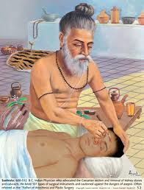
Spiritual Masters Contributed to Science
A number of spiritual scientists (philosophers, rishis), also made great scientific contributions in a number of fields.

Slide 55
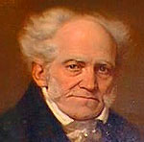
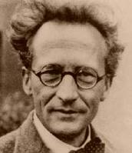
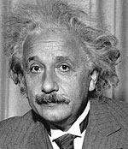
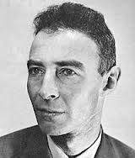
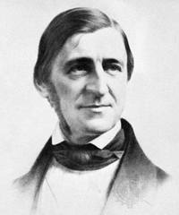
Modern Scientists and Thinkers Who Were Deeply Spiritual
A number of modern scientists and thinkers were themselves very spiritual and have even showered glowing praises for scriptures like The Gita and the Upanishads, Ramayana, and the Vedanta philosophy in general.
Albert Einstein
Robert Oppenheimer
Ralph Waldo Emerson
Arthur Schopenhauer
Erwin Schroedinger

Slide 56
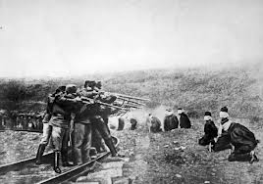
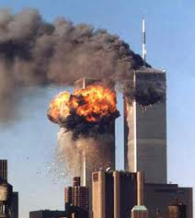

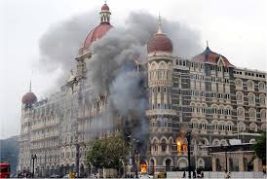
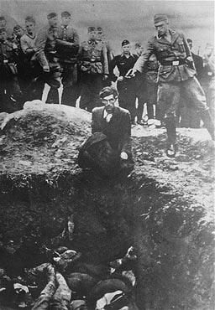

Even if that is true, we still don’t want anything to do with spirituality or religion because it leads to fanaticism, terrorism and wars...

Slide 57
Does spirituality lead to fanaticism?
In fact, fanaticism is caused by misinterpretations of spiritual concepts, which are forced upon the public as religious dogma (beliefs that are accepted without evidence or reason).
Spirituality is the discovery of the Truth.
Dogma and fanaticism are perpetuated by selfish people who do not want to accept the Truth that is inconvenient to their selfish interests.
Spiritual knowledge proceeds by eliminating errors, misconceptions and misinterpretations.
Spirituality provides clarity and peace.

Slide 58
OK, spirituality might be a rational truth-seeking process, but don’t all religions demand blind faith?
What’s the connection between religion and spirituality anyway?

Slide 59
What is the Difference Between Spirituality and Religion?
Spirituality: Universal knowledge.
Common philosophical foundation of all religions.
Rational analysis...explains the ‘why’ behind religious practices/traditions.
Religion: bringing that knowledge to practice in our lives.
Core universal practical path of:
pursuing the spiritual goal &
peaceful coexistence with other people (ethics)
Culture:
External customs and social behavior.
It differs from place to place.
It is often influenced by the region’s history, geography, climate, and other conditions.

Slide 60
World Religions: Blends of Spirituality, Religion and Culture
Spirituality (Theory) | Foundation of universal philosophy (spiritual knowledge).
Religion (Practice) | Worship of God for achieving the spiritual goal. Maintaining social justice (ethics). Initially, the practical part is often followed without understanding. Through spiritual knowledge the reasons are discovered.
Culture (Style) | Different presentation of common content in each religion. To suit the pre-existing customs and the mentality of the people. Symbols & rituals are teaching tools that help in the assimilation of spiritual knowledge and guide the practice.

Slide 61
World Religions: Same Drink in Different Cups
Common Drink → Universal Spiritual Knowledge.
Common Cup → Universal Religion.
Different Shapes of the Cups → Cultural Differences.

Slide 62
Analogies for Relation Between Spirituality & Religion
 | Components of World Religions | Analogy: School Education System
1. | Spiritual Knowledge | Common universal curriculum for all schools.
2. | Religion | Common practical steps in learning: (a) Attending classes, completing assignments, and passing examinations. (b) Peaceful co-existence with other students
3. | Culture | Different schools with different mediums of instruction (language), uniforms, organizational rules and regulations as per people’s mentality and local conditions.

Slide 63
Spirituality is to Religion as Science is to Technology
Both science and spirituality are theoretical and hence positive (descriptive/factual).
Science and spirituality only explain facts.
They do not prescribe or force any particular action.
E.g. 1. the scientist explains that petroleum is highly combustible and can burn violently.
E.g. 2. “The results of the good/bad actions of each person certainly come back to the person. ”
But both technology and religion are practical and hence prescriptive/normative.
They prescribe a particular action, since they are both application-oriented.
E.g. 1. The engineer prohibits his workers from lighting a fire anywhere near petrol tanks.
E.g. 2. “Thou shalt not kill.”

Slide 64
Let’s try to further clarify the relation between spirituality and religion by taking another analogy...

Slide 65

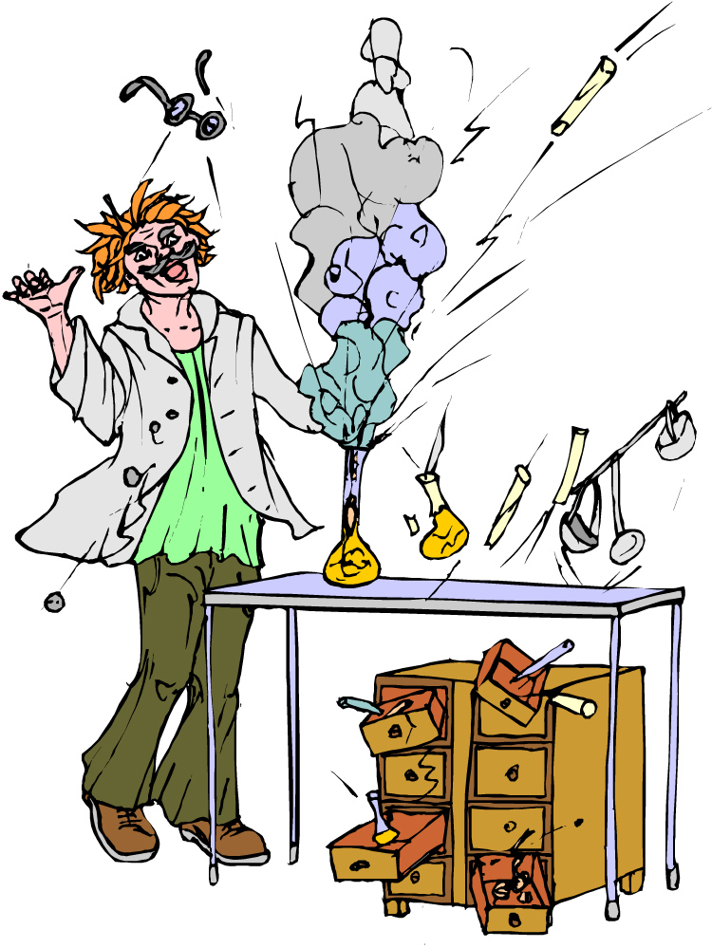
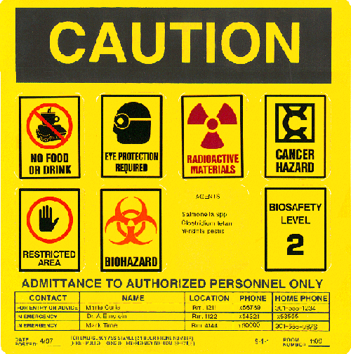

Analogy: Chemistry and Lab Instructions
The scientist understands the properties of chemicals in a chemistry lab and their dangers to humans.
But most students do not understand them.
So, to make it simple for the students and ensure their safety, laboratory safety rules are given in the form of dos and don’ts.
It is essential to follow the dos and don’ts in the chemistry lab whether students understand the reason behind them or not.

Slide 66
The relation between:
the deeper concepts in chemistry and
the laboratory dos and don’ts
is same as the relation between:
spirituality
and
religion...

Slide 67
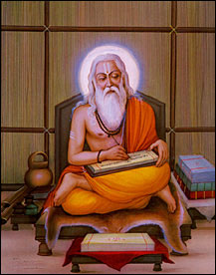

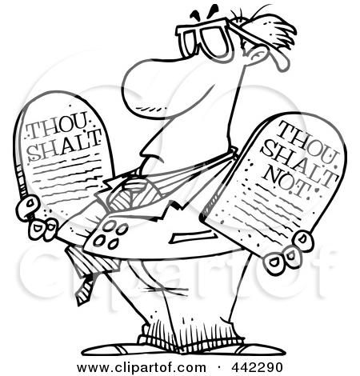
Spirituality & Religion
The sages who had a deep understanding of spiritual principles, realized the relation between our actions and their consequences
But common people could not understand it.
To make things easier for them and to ensure societal peace, the sages gave them simple moral codes (dos and don’ts) to be followed whether or not people understand the reason behind them.—Religion

Slide 68
Spirituality is the Basis of Morality
Those who wish to discover the reason (deeper principles) behind the dos and don’ts are welcome to study spiritual knowledge.
That is why spirituality is the basis of morality.
Without spiritual knowledge, it is extremely difficult to convince a person why he should be moral.

Slide 69
If spirituality is actually that good, then why are so many so-called ‘spiritual’ people not following spiritual principles?
They are getting involved in corruption, scandals and crime…
Why can’t they practice what they preach? They are hypocrites!

Slide 70
Are Spiritual Followers Hypocrites?
Hypocrisy is a false show of a certain attitude or behavior in public, which one does not really possess.
It is a human trait that applies to persons in all fields; not just spirituality.
It is argued that spiritual followers are hypocrites and do not practice what they preach. .
Some individuals have a greater tendency towards hypocrisy than others.
An aspirant on the spiritual path has, by definition, not reached the goal. So, a gap between his thinking and practice is inevitable.
For example, an engineering student is not an expert at engineering yet; but he will eventually become.
Some aspirants claim to be greater or better than they actually are, to gain respect or benefits from others.

Slide 71
Are Spiritual Followers Hypocrites?
Thus, the inevitable gap between the understanding and practice of spiritual followers, or individual tendencies for hypocrisy, cannot be reasons for rejecting spirituality altogether.
In fact, hypocrisy results only from an incomplete understanding and assimilation of important spiritual concepts.
Progressing further to assimilating those concepts will remove the tendency eventually.
This only emphasizes the importance of acquiring an accurate and complete understanding of spiritual knowledge, assimilating it fully and practicing it in our lives.

Slide 72
There are some serious doubts regarding the validity of spiritual knowledge.
How do we know it is true and correct? Some of the claims made by spirituality are impossible to even verify.
So, when it’s reliability itself is doubtful, why bother about it?

Slide 73
Is Spiritual Knowledge Valid and Reliable?
Spiritual knowledge is as valid as science; if not more.
Both science and spirituality deal with two types of items (to be known):
Items/concepts that can be directly perceived by our 5 senses.
Items/concepts that cannot be directly perceived.
Spiritual knowledge discusses about some concepts such as heaven, hell, God, rebirth, etc., which are difficult/impossible to directly verify.
Science too has concepts that are difficult/impossible to directly verify: e.g. subatomic particles, concepts in theoretical physics, some laws of thermodynamics, and concepts in cosmology.

Slide 74
Is Spiritual Knowledge Valid and Reliable?
Both science and spirituality rely on common means of acquiring knowledge about both types of items and verifying its validity:
direct perception:
for items that are perceptible to senses.
indirect perception:
For items that are difficult or impossible to perceive, logical theories (sometimes assisted by instruments) can be used.
The observations are perceptible.
The theory (logic) relates the observations with the imperceptible object in such a way that it does not contradict alternative (indirect) ways of verification.
Thus, by making the relevant observation, one can infer even imperceptible facts.

Slide 75
Is Spiritual Knowledge Valid and Reliable?
Example of indirect perception (through logic) in science.
The atoms present in a chemical sample are imperceptible.
So to identify elements, we use a combination of an instrument called a spectrometer and logical theory.
A visual display of a spectrum can be related to the presence of certain elements through an elaborate theoretical analysis, which is in agreement with other forms of evidence.
While this theoretical analysis is too complicated and abstruse for a lay person, it is as good and reliable as direct evidence for experts in that field, who are familiar with that theoretical analysis.
A lay person must believe the word of the expert or else study the entire theory and verify for himself.

Slide 76
Is Spiritual Knowledge Valid and Reliable?
Spiritual knowledge also uses indirect perception in a similar way.
Spiritual scholars have their own theories to relate observations in the world to concepts that are not perceptible.
For them these theories are extremely reliable and inferences based on them are as good as direct knowledge.
But most of us are lay persons to spiritual knowledge and have never studied those spiritual theories.
We can either accept the word of the experts in spiritual knowledge or else study the entire theory and verify for ourselves.
We are surely in no position to reject of dismiss these theories without analysis.

Slide 77
Is Spiritual Knowledge Valid and Reliable?
Apart from direct and indirect perception, spirituality uses an additional means: Scripture (Revealed Word).
That Entity, from which this world came and by which it is maintained, can certainly make Itself known to us along with a number of other facts that are inherently difficult/impossible to verify.
In fact, statements from Scripture are very similar to the postulates of science.
A postulate/axiom is something that is considered to be true, which acts as the basis for any reasoning or discussion, and for which no contradiction has been found so far.
Spirituality has a immense wealth of such ‘postulates’ in the form of scriptures.

Slide 78
Identical Means of Getting Knowledge: Science and Spirituality
Means of Knowledge | Science | Spirituality
Fundamental principles that cannot be proved rigorously, but are never violated and they form the basis of theoretical analysis | Postulates | Scripture
Direct Perception by 5 senses | Yes | Yes
Indirect perception: Perception of observations, linked to imperceptible items through theory (logic) and sometimes through instruments | Yes | Yes

Slide 79
Even if spiritual knowledge is reliable and valid, why waste time on it?
It is not even relevant to us in modern times. Don’t we have more important things to do in life, like pursuing our profession?

Slide 80
Is Spirituality Relevant to Me?
All beings are subject to the same physical and metaphysical laws that govern this creation.
Animals follow the laws by default since they are programmed by nature and have no free will.
Humans have the privilege of learning and understanding these laws and living accordingly so that no harm comes to them.
Being ignorant of the laws or disregarding them does not exempt you from their influence in any way.
Spirituality is most essential for every intelligent and practical person, who is interested in his/her own ultimate benefit.

Slide 81
Is Spirituality Relevant to Me?
Basic subjects such as mathematics, science and social sciences, are taught to every student in school irrespective of the student’s future career inclinations, since that knowledge is considered to be essential for every citizen.
The necessity of spiritual knowledge is even more fundamental in that it provides the basic manual for living and leading one’s life.
Ironically, no subject in modern education teaches and trains you in this art.
Yet we do not seem to be bothered by it and continue to lead our lives blindly!

Slide 82
Is Spirituality Relevant to Me?
Leading a life without a goal cannot be modernism:
In the modern world, no project/mission/organization is ever started without a goal.
Yet ironically, we have never bothered to find out the goal of our own life!
Ignorance about our actions and their results.
Every living being must perform action even to survive.
But each action of ours has consequences—some immediate and some delayed.
Action-result are governed by some laws, which are essential for us to know.
We ceaselessly perform actions throughout our lives in total ignorance of the laws governing actions. Hence, we sometimes even hurt ourselves in the process.
‘Modern’ life is the climax of blindness!

Slide 83
Spirituality is Most Essential for Me!
Spirituality deals with human life and hence, is very much relevant to us.
Spirituality explains :
The goal of human life
The way to lead our life so that we can avoid important pitfalls and obtain maximum happiness and satisfaction from our lives.

Slide 84
If spiritual knowledge is the most important knowledge, why don’t we just study spirituality?
Why should we unnecessarily study science?

Slide 85
Necessity of Science for Spirituality
Both science and spirituality are the analysis and discovery of the Reality.
Spirituality is particularly concerned with the Ultimate Reality.
But a number of errors can creep into this analysis.
The progress in science has provided invaluable clarity by eliminating many of these errors in the spiritual analysis.
e.g. Literal interpretations of metaphors in the scriptures, by some spiritual followers led to misunderstandings that “light”, “fire”, “sound” or “awareness” are the Ultimate Reality (God).
Modern science has clarified that all these are mere forms of energy.

Slide 86
Science and the Ultimate Reality
The scriptures say that the Ultimate Reality (God), which is the Source of this universe, is:
Beyond all forms.
Beyond even the ‘formless’ entities like water, energy, space and time.
Beyond logic or imagination of the human mind—(completely and permanently unimaginable).
Its existence alone can be detected; Its nature remains permanently unimaginable.
It is possible to detect the existence of an entity without knowing its nature.

Slide 87
Science and the Ultimate Reality
Science indicates the existence of an unimaginable entity or domain:
Unimaginability is inherent in the concept of “infinity” such as the “infinite boundaries of space”.
The uncertainty principle—which points out that the reality can never be determined by our mind (logic).
“Not only is the universe stranger than we imagine, it is stranger than we can imagine.”—Sir Arthur Eddington (Astrophysicist, Philosopher).

Slide 88
If spiritual knowledge is so important, why are so many people including scientists against it?
Why is spiritual knowledge not included in the curricula of schools?

Slide 89
The Divorce of the Millennium:
Education vs. Spiritual Knowledge
Modern science was born in the West out of the struggle of truth-seeking scientists against religious dogmatic leaders.
Hence, science is thought to be anti-religion.
It does not mean that science and God are actually opposed to each other.
Innumerable scientists of the past and present, many of them world famous, accept the existence of God.
For fear of conflicts between the dogmatic beliefs of different religions and between religious dogma and science, spirituality has been excluded from our public life.
It is like giving up cooking for fear of smoke!
The exclusion of spirituality from public life is dressed up as secularism.

Slide 90
The Divorce of the Millenium:
Education vs. Spiritual Knowledge
Most tragically, spiritual knowledge has been filtered out of the educational system.
Generations have passed bearing the misconceptions that:
Worldly knowledge alone is adequate.
Spirituality is irrelevant to human life.
Spirituality is opposed to science.
The biggest joke is that these conclusions have been made without even a basic understanding about spiritual knowledge!
In the absence of spiritual knowledge, there is no wonder that the moral integrity of individuals in society is degrading rapidly, leading to the environmental and social crises!

Slide 91
For Spiritual Education: Catch Them Young!
Imbibing spiritual knowledge, analyzing it thoroughly, and developing a strong moral character, requires a lot of time.
It can be best accomplished when started from a young age, when character and habits are still forming.
So it is imperative to integrate spiritual knowledge with conventional education from a very young age.
This alone can produce generations of self-controlled humans with high moral values...in the long run.
The wheels of true spiritual knowledge turn very slowly; but they grind most surely and finely.

Slide 92
Can regular education and spiritual knowledge be integrated?
Can education and spiritual knowledge be integrated?
Will this integration lead to a fair society and protection of the environment?
Certainly! And there is a precedent too!
Incidentally, modern (western) society is not the first society to be an education-based society.

Slide 93
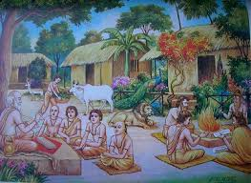

Slide 94
Sustainability of The Vedic Society
The ancient Indian (Vedic) culture, was a knowledge-based culture. “Veda” itself means “knowledge”.
Education was started at an early age (like today).
But spiritual and worldly knowledge were integrated.
In the formative years of a child, the education given was predominantly spiritual.
There was great emphasis on complete and deep understanding through analysis and discussion. It was not dogmatic moral instruction.
Questions from the student were encouraged and answered at length.
Learning was through listening from the Guru, by following the Guru’s example, by observation (of oneself, others and nature), and through performing practical action.

Slide 95
Sustainability of The Vedic Society
The focus was on dedicating one’s life to far higher goals than mere survival.
Dharma (righteous, just or moral behavior) was the ideal for everyone.
The greatest Dharma was defined as “Ahimsa” which is not harming any living being (humans, animals & plants).
The law of Karma, heaven and hell were explained in detail as a reward and penalty system; rather than as a threat.
This society produced great stalwarts of impeccable character.
Of course there were unjust people and criminals, but they were very few (unlike today).

Slide 96
Environmental Protection In Vedic Society
Environmental protection through deification of Nature.
Wise ones superimposed divinity on items in Nature to ensure their protection, even when their actual utility could not be understood by ignorant masses.

Slide 97
Integration of Science and Spirituality
The same high standards of moral integrity can be achieved even today if true spiritual knowledge is integrated with worldly education.
This is also the vision of Amma and our University.

Slide 98
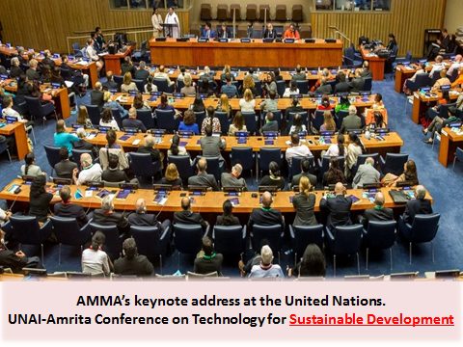

Slide 99
I often reflect deeply on the future of the Earth, the preservation of nature, and the disappearing harmony between humanity and nature. This contemplation has led me to the conviction that science, technology, and spirituality must unite in order to ensure a sustainable and balanced existence of our world. The present age and the world around us demand this transformation.
AMMA

Slide 100
Renowned scientists of the past viewed the universe and its subtleties with awe and wonderment. Their research had the inquisitiveness and faith of an innocent child. In fact, many past and present eminent scientists acknowledged spirituality towards the end of their lives. But, by then it was too late. Amma prays that the scientific community leading the world today does not make this same mistake.
AMMA

Slide 101


Mission
To provide value-based education and mould the character of the younger generation through a synthesis of science and spirituality, so that their earnest endeavour to achieve progress and prosperity in life is matched by an ardent desire to extend selfless service society, one complementing the other.

Slide 102
Integration of Spiritual Knowledge in Education Leads to Sustainability
Spiritual knowledge taught in a rational manner from early childhood, allows the individual to internalize the concepts and develop a firm conviction.
This enables the individual to become a responsible citizen of the unshakable moral integrity, since his morality is based on the firm foundation of an accurate and complete understanding of spiritual knowledge.
Any technology or economic development carried out by people of such high moral integrity will automatically be sustainable.
They will be able to control their consumption with the knowledge that:
Consumption is not the goal of life and not even beneficial beyond a point.
Unethical consumption is going to cause considerable personal loss to them, even if they can escape the law of the land.

Slide 103
Integration of Spiritual Knowledge in Education Leads to Sustainability
They will utilize science (knowledge) in such a way that will ensure prosperity of society while minimizing environmental impacts.
Morally sound entrepreneurs, engineers, professionals and consumers will ensure that development is sustainable (even if not mandated by law). Of course the law is an essential deterrent for the invariable (but rare) defaulters.
They will thus be able to avert the tragedy of the commons and achieve sustainable development.
Governance, policy, business frameworks and appropriate technology meeting the new requirements of sustainable development will have to evolve.

Slide 104
Unsustainability: Cause and Solution
Unsustainable development is due to unethical resource consumption and is a failure of human morality; not science.
Unethical consumption (corruption and overconsumption) is due to two misconceptions:
Consumption is the goal
Unethical consumption has no personal adverse consequences
Rational spiritual knowledge, which is the basis of morality can help achieve ethical consumption (and sustainability) effortlessly.
Solutions:
Real and Long Term Solution: Integration of true spiritual knowledge with regular education alone can lead us to sustainability in the long run.
Immediate and Symptomatic Solution: In the short term, sustainability-based governance, policy, business frameworks and appropriate technology will have to be developed and implemented.

Slide 105
Fine, spiritual knowledge is the ultimate solution of all human problems.
Integrating spiritual spiritual knowledge with worldly knowledge in a child’s education will ensure permanent sustainability in the long term.
But where is this spiritual knowledge available?

Slide 106
Where is Spiritual Knowledge Available?
Scriptures of various religions in the world
They contain the universal spiritual knowledge explained in the region-specific and people-specific context.
Mostly, it is mixed with some moral codes.
The differences between scriptures are due to the different contexts in which they were revealed; they are not differences in the essential knowledge.
However, the concepts are extremely subtle and complex and we are unfamiliar with the context and background in which that knowledge was revealed. So, mere reading of the scriptures can often lead to a misunderstanding of the actual concepts. Correct interpretation requires great expertise.
Nevertheless, they are the repository of valid spiritual knowledge.
They can be considered to be the standard against which the validity of any concept or theory in spirituality must be tested.

Slide 107
Where is Spiritual Knowledge Available?
Teachers from scriptural teaching traditions
The subtle and complex concepts in the scriptures, require high preparation of the receiver and an able teacher.
Almost all religious and philosophical schools have their own teaching traditions taught by trained teachers.
They are generally mixed with the religious aspects of that tradition, which are generally helpful for the student.
This traditional learning can provide some basic exposure but not the highest spiritual knowledge, nor the highest spiritual accomplishment.

Slide 108
Where is Spiritual Knowledge Available?
Sadguru: highest accomplished Master and embodiment of Divinity.
Only he who has personally and practically accomplished the concepts being taught, can give the highest spiritual knowledge and enable practical accomplishment in the student.
e.g. Only a coach who has himself succeeded at the Olympics can train another sportsman for the Olympics.
Such a Guru (teacher) is said to be the Sadguru (Sat+Guru) — the true Guru, who is the embodiment of Divinity.
Correctly identifying a genuine Sadguru and learning from Him is the surest path to the highest spiritual success.

Slide 109
Sources of Spiritual Knowledge
Source | Quality | Max level achievable (analogical)
Learning from Sadguru | Best | PhD
Learning from traditional guru/acharya | Better | M.Tech
Self-study of scriptures | Good | B.Tech

Slide 110
As teachers, we are married to knowledge and truth.
Even as we grope in the dark ourselves, we are obligated to find the light and lead society to it.

Slide 111
Extra Slides
On some practical steps and principles in designing sustainable communities.

Slide 112
Principles of Sustainable Technology and Business Development
Question the need for any technology in the first place.
Is it even a basic need?
Can it be satisfied by a commonsense solution rather than using technology. (e.g. old curtains can be stitched into cloth shopping bags. The technology of the non-recyclable UHMPE carry bags is not even necessary!
Do you really need to develop the technology to grow strawberries in a semi-arid place? Indian jujube (ber) grows wild in these places without irrigation and is far more nutritious!
Even the consumer can enquire: “Do I really need a plasma television in every room to feel entertained or do I actually crave for the care and love of my family?”

Slide 113
Principles of Sustainable Technology and Business Development
Find the lowest technology solution to satisfy the need
E.g. A zero technology kitchen garden plot of a few square meters provides tasty organic vegetables and fruits on inputs of (i) your own kitchen organic waste and, (ii) greywater from your own kitchen and shower rooms. It solves several problems to a substantial extent: food and nutrition, freshwater scarcity, solid waste management and domestic effluent treatment. Besides, its is a great way to enjoy togetherness with your family and reduce TV watching and obesity.
E.g. Using herbal items like soapnut, shikakai, neem, vinegar, etc. as cleaners and disinfectants, eliminates the need for a vast gallery of chemical industries. These plants can grow even without irrigation in your backyard or neighborhood and serve many ecosystem functions. If you use these natural non-toxic cleaners, your greywater can be used directly for garden plants, without any effluent treatment.

Slide 114
Principles of Sustainable Technology and Business Development
Rethink (and re-engineer if required) systems, processes and actions at all levels.
All engineering systems involving ecosystem components have to be developed on sound ecological principles.
e.g. agriculture can be replaced by agro-ecosystems like food forests.
A Systems Approach to Waste Management

Slide 115
Principles of Sustainable Technology and Business Development
Localize material requirements (shorten the supply chain):
Food requirements can be satisfied within a 5 km-radius.
Clothing, building materials etc. within a 100 km radius.
Globalize information:
Information communications technology, can reduce materials use drastically.
It can save unnecessary human transportation.
It can help design simple and more efficient products, structures, processes and systems.

Slide 116
Principles of Sustainable Technology and Business Development
For industrial production:
Develop “Industrial Symbiosis Networks” for industries where ever possible so that wastes and byproducts of one industry can be utilized by another leading to an overall minimization of the resources required and waste generated. Preferably a closed cycle supply chain.
Within each industry, process and resource integration should be implemented, whereby waste products, heat and water from one process should be fed to another process.
For each process, proper design, monitoring, and control to be done to maximize efficiency.
All industries to follow strict environmental and personnel health and safety standards.

Slide 117
Principles of Sustainable Technology and Business Development
Life cycle analysis for all products and due labeling.
Internalizing environmental and social costs in product cost.
Reverse supply chain for recycling products
Responsible product advertising
Responsible media
Similar principles for policy and governance and every walk of life.

Slide 118
Central Message for Students
All environmental and social problems are inextricably connected. No isolated solution is possible.
Hence, sustainable development (the confluence of the 3 preoccupations) is the goal. Present unsustainability is the problem.
Most common solutions to unsustainability (based on technology, management, legislation, regulation reforms etc.) are superficial, partial and temporary.
A true and permanent solution requires a fundamental approach.
Unsustainability is a moral issue. True sustainability can be achieved only if all the above solutions are implemented in a society of high moral standards.
Morality must be based on a firm foundation of spirituality; else it is flimsy.
Society, firmly grounded in spiritual knowledge (leading to morality), must develop appropriate technology, organizations, policies and governance principles.

Slide 119
Outline
Objectives of The Topic
What is Unsustainability?
Why are Most Conventional Solutions Inadequate?
Does Technology Cause Unsustainability?
Is Unsustainability is a Moral Issue?
What is the Root Cause of Unsustainability?
What is the Permanent Solution to Unsustainability?
What are Some of the Objections to Spirituality?
Spirituality and Education
Sustainability Cause and Solution
Some Principles for Sustainable Technology Development

Slide 120
A complete restructuring in technology, governance, policy and business is necessary for sustainable development; but not sufficient because:
Our understanding of natural systems and human behavior is too limited. Hence, technological, management or other solutions can go either way—They might solve problems or lead to new ones.
Moreover, it is people who are responsible for the overconsumption of resources and corruption and injustice in society. Man is the common factor in:
man-environment interactions—leading to environmental problems
man-man interactions—leading to social problems.

